Slide 1

Evaluating U.S. Opioid Prescribers
Bryan Crigger, Xiangzhen He, James Hurst, Jazmin Logroño
IST 707

Slide 2
The Problem
There were over 75,000 opioid related overdose deaths in the United States in the 12-month period ending in April 2021 (CDC).
More than 932,000 people have died since 1999 from a drug overdose (CDC).
Two out of three drug overdose deaths in 2018 involved an opioid (HHS).
In 2016, the national rate of opioid-related hospitalizations was 297 per 100,000 population (HHS).
In 2022, COVID-19 deaths per 100,000 people is 307 (Johns Hopkins).
Our Goal: Classify and evaluate opioid prescribers to highlight possible anomalies, identify high risk areas and prescriber types to assist early intervention programs.

Slide 3
Our Data
Data provided by the Centers for Medicare & Medicaid Services.
Contains summaries of prescription records for 250 common opioid and non-opioid drugs written by 971,968 unique licensed medical professionals in 2019.
971,968 observations and 254 variables.
Some Key Variables:
Prescriber State, Medical Specialty, Drug Name.
Identification of opioid drugs
Used generic names instead of brand names to find the ten total generic drug names for opioids in our data.
Used these ten drugs to create a Boolean label of "Opioid Prescriber" in our data.

Slide 4
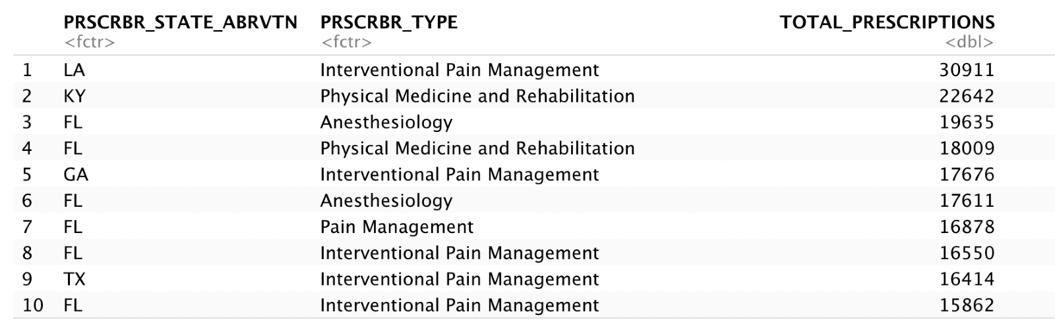
Data Exploration
183 different medical specialties.
59% of the prescribers did not prescribe any opiate drugs in 2019.
Identified an outlier in Louisiana who had prescribed 30,000+ opioid prescriptions.
Identification of skew towards the Southeast U.S., which only has two of the top five U.S. states based on population size.
Top 10 opioid prescribers ranked by total number of opioid prescriptions

Slide 5
Association Rule Mining
Lhs (Prescriber Type) | Rhs (Drug Information) | supp | conf | lift
Family Practice | TRAMADOL.HCL=10-500 | 0.1371 | 0.8050 | 1.4827
Family Practice | HYDROCODONE.ACETAMINOPHEN=10-500 | 0.1263 | 0.7413 | 1.2207
Internal Medicine | TRAMADOL.HCL=10-500 | 0.1080 | 0.7824 | 1.4409
Orthopedic Surgery | HYDROCODONE.ACETAMINOPHEN=10-500 | 0.0306 | 0.7393 | 1.2174
Emergency Medicine | HYDROCODONE.ACETAMINOPHEN=10-500 | 0.0434 | 0.7212 | 1.1876
The rules suggest that if the prescriber is:
Family Practice: ~81% likely to prescribe Tramadol and ~74% likely to prescribe Hydrocodone Acetaminophen 10-500 times a year.
Internal Medicine: ~78% likely to prescribe Tramadol 10-500 times a year.
Orthopedic Surgery and Emergency Medicine: ~73% likely to prescribe Hydrocodone Acetaminophen 10-500 times a year.
The lift value for each rule is greater than 1.

Slide 6
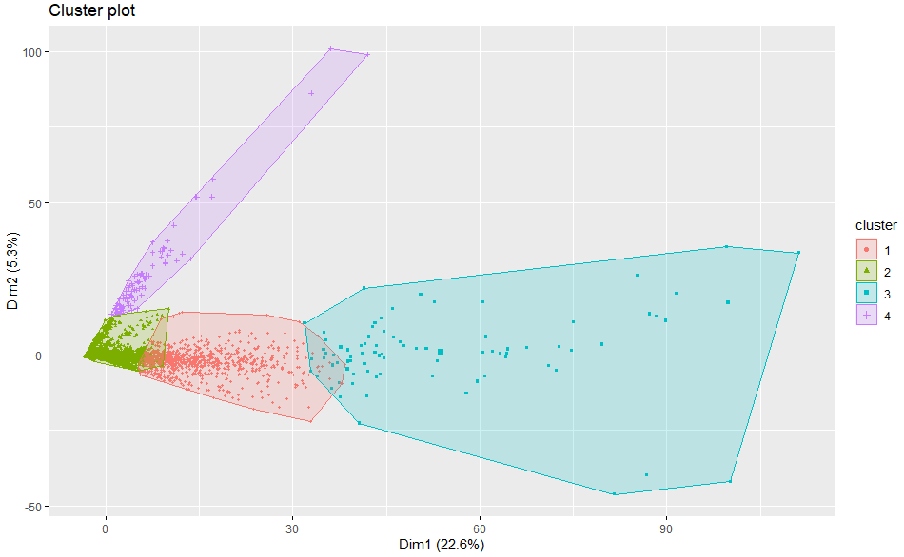
Clustering
Design:
Data Cleaning: Subset the data to the Top 20 most common Prescriber Types (90% of all observations).
Feature Reduction: Identified top 18 drugs that explained 50% of the cluster prediction.
Findings:
Optimal cluster model grouped all prescribers best into 4 clusters
Of the top 10 highest predicting factors, 9 of them were opioid drugs

Slide 7
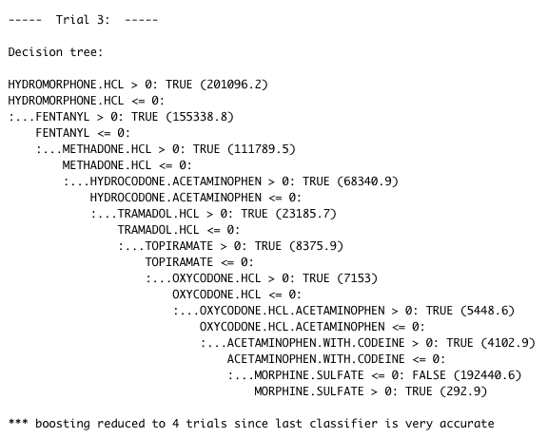
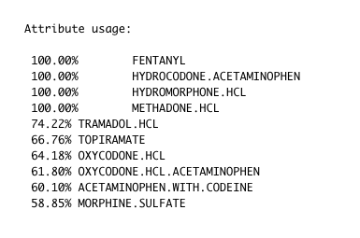
Classification: Decision Tree
C5.0 correctly classified 100% of the training data in ~24 minutes.
Average tree size was 10.2.
Model accuracy was 100% on the validation set (unseen data).
8/9 Splitting Attributes are Opioids.

Slide 8

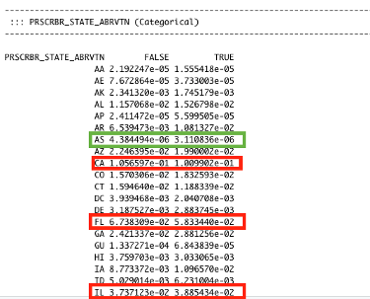
Classification: Naïve Bayes
States with high conditional probabilities for Opioid Prescriber = True: California, Texas, Florida, New York, Pennsylvania, Ohio, Illinois, and North Carolina.
American Samoa had the lowest conditional probability for Opioid Prescriber = True.
Prescriber Type with high conditional probabilities for Opioid Prescriber = True: Family Practice, Internal Medicine, Physician Assistant, Orthopedic Surgery, and General Surgery.
72.8% accuracy on the validation set (unseen data).

Slide 9
Conclusion
Limitations
Unable to normalize our data against state population size.
Unable to incorporate socio-economic factors into our analysis to help account for some of what drives opioid overdoses.
Outliers
Durable Medical Equipment & Medical Supplies has one opioid prescriber in 2019, but that one person ranked fourth among all medical specialties for average opioids prescriptions.
High risk areas are in the Southeastern region of the United States.
Key Model Takeaways
Four of ten opioids had 100% attribute usage in our decision tree.
Family Practice was highly likely to prescribe Tramadol or Hydrocodone Acetaminophen 10-500 times a year in our association rule mining.

